Slide 1
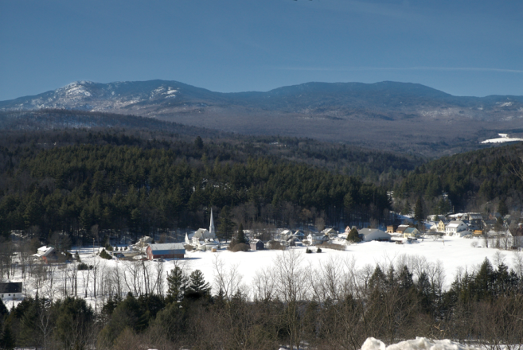
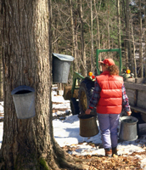
Education and Prevention Subcommittee Mandated Report to the Commission November 14, 2017
Mark A. Levine, MD, Commissioner

Slide 2
“In order to establish a common baseline understanding of the most credible data regarding health endpoints of marijuana use and safety impacts of legalization…the subcommittees shall assess high quality primary research, including evidence-based Vermont data to the extent it is available for the following groups of health and safety endpoints and report to the Commission.”

Slide 3
Levels of Evidence
Conclusive = Randomized controlled trials
Substantial = Strong evidence to support a statistical association; good quality studies
Moderate = Some evidence; good to fair quality studies
Limited = Weak evidence; fair quality studies or mixed findings
Insufficient = Mixed findings or minimal study

Slide 4
What Reduces the Level of Certainty in a Study’s Conclusions?
Chance: Random variation from sample to sample.
Bias: Systematic error in the way individuals are selected into the study or the way in which information is collected or reported.
Confounding: An observed association between an exposure and disease could be due, totally or in part, to the effect of other baseline differences between groups that were unrecognized or uncontrolled.

Slide 5
Ecological Fallacy

Slide 6
Evidence that an Association is Cause and Effect
Criterion Comments
Temporality Cause precedes effect
Strength Large relative risk
Dose-Response Large exposure to cause associated with high rates of disease
Reversibility Reduction in exposure associated with lower rates of disease
Consistency Repeatedly observed by different persons, in different places, circumstances and time

Slide 7
Committee Process
Materials Used:
VDH Health Impact Assessment 2016 and update 2017
National Academy of Medicine Health Effects of Cannabis and Cannabinoids
Extensive medical literature review
Committee Discussions and review of report

Slide 8
Summary of Findings

Slide 9
National Survey on Drug Use and Health

Slide 10
Past Month and Past Year Marijuana Use in the US and VT

Slide 11
Youth Risk Behavior Survey (YRBS)

Slide 12
Young Adult Survey

Slide 13
Injury and Death
Limited evidence to support or refute a statistical association between cannabis use and:
All cause mortality
Occupational injuries
Deaths due to cannabis overdose
Substantial evidence for cannabis use and:
Cannabinoid Hyperemesis Syndrome
Emergency Department Use
Moderate evidence for cannabis use and:
Fatal car crashes

Slide 15
Vermont marijuana-related hospital admissions

Slide 16
Cannabis Hyperemesis Syndrome
Change in the rate per 100,000 of individuals presenting to VT Emergency Departments

Slide 17
Prenatal, Perinatal Exposure to Marijuana
Moderate evidence for concerning increasing use among pregnant women.
Insufficient evidence for association between maternal cannabis smoking and long-term offspring outcomes (cognitive function, subsequent substance use).

Slide 19
Psychosocial Consequences
Moderate evidence for cannabis use and:
Impaired academic achievement
Lower income and unemployment

Slide 20
Mental Health
Substantial evidence for cannabis use and:
Development of acute psychosis and chronic psychotic illness such as schizophrenia.
Insufficient evidence for development of PTSD or bipolar disorder.

Slide 21
Problem Marijuana Use
Substantial evidence for cannabis use frequency and development of cannabis use disorder, which is then subsequently associated with diagnosis of other psychiatric disorders.

Slide 22
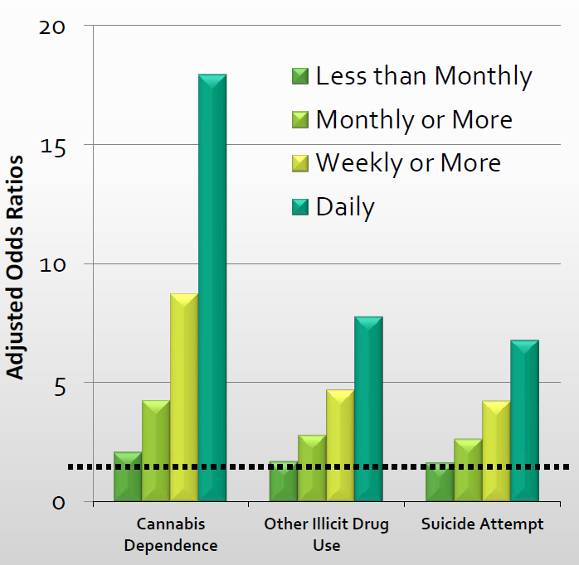
Frequency of Use and Risk of Cannabis Dependence, Other Drug Use, and Suicide Attempts
Silins et al. (2014). Young Adult Sequelae of Adolescent Cannabis use: An Integrative Analysis. The Lancet Psychiatry, 1, 286-293.
Based on three prospective longitudinal studies from Australia and New Zealand.

Slide 23
Marijuana Use and Abuse of Other Substances
Moderate evidence for association between cannabis use and development of alcohol use disorder.
Limited evidence for association between cannabis use and development of opioid use disorder.

Slide 24
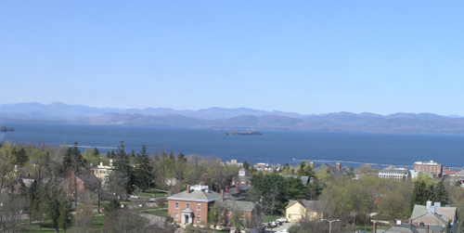
Mark Levine, MD, Commissioner, Vermont Department of Health mark.levine@vermont.gov http://healthvermont.gov/
Thank you
Source: http://www.hazecam.net/camsite.aspx?site=burlington
Notes:
.

