Slide 1
The Vermont Department of
Liquor Control
An Overview of the Department and the Control Model

Slide 2
Department of Liquor Control Mission
Our mission is to serve the public by preventing the misuse of alcohol and tobacco through controlled distribution, enforcement, and education; as well as provide excellent customer service by operating efficient, convenient liquor agency stores throughout the state.

Slide 3
DLC Fast Facts:
In conjunction with our Agency Partners the DLC operates 80 retail locations throughout Vermont
The Department operates a 30,000 ft² Distribution Center
The DC contains over 1700 SKUs
The Department owns and operates seven 28-foot delivery trucks
The Department offices and original DC were occupied in 1961
An addition was put onto the original DC in 1973
The Department issues 13,000 licenses and permits each year

Slide 4
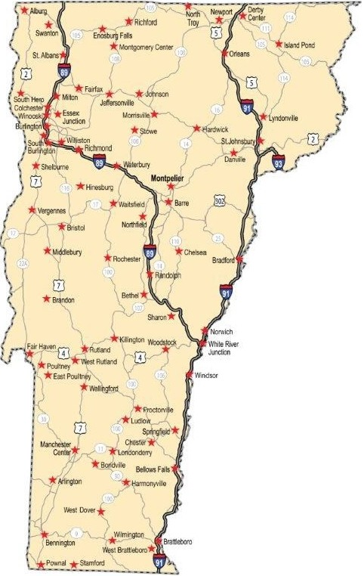
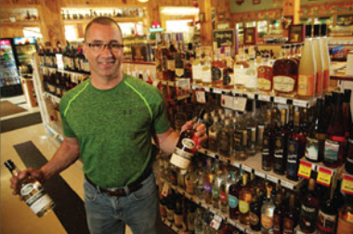
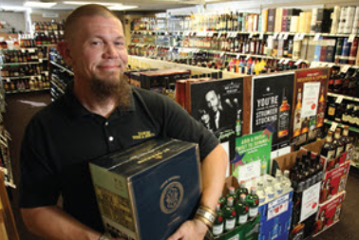
DLC 80 Agency Store Locations

Slide 5
DLC Fast Facts:
Department has a staff of 55 employees including:
50 Classified – 3 Exempt – 2 Limited Service
14 Certified LEOs who work in the Compliance & Enforcement Division
15 Distribution Center Employees both product pickers and delivery drivers
4 Retail Coordination Staff
4 IT Staff who maintain our 80 retail locations & DC systems
4 Administrative Staff who assist with licensing, education and enforcement
3 Business Office Staff
2 Educators who both teach in-person and produce on-line training
2 Purchasing Coordinators
1 Director of Marketing
1 Licensing Chief
1 HR Staff
A Commissioner and Deputy Commissioner

Slide 6
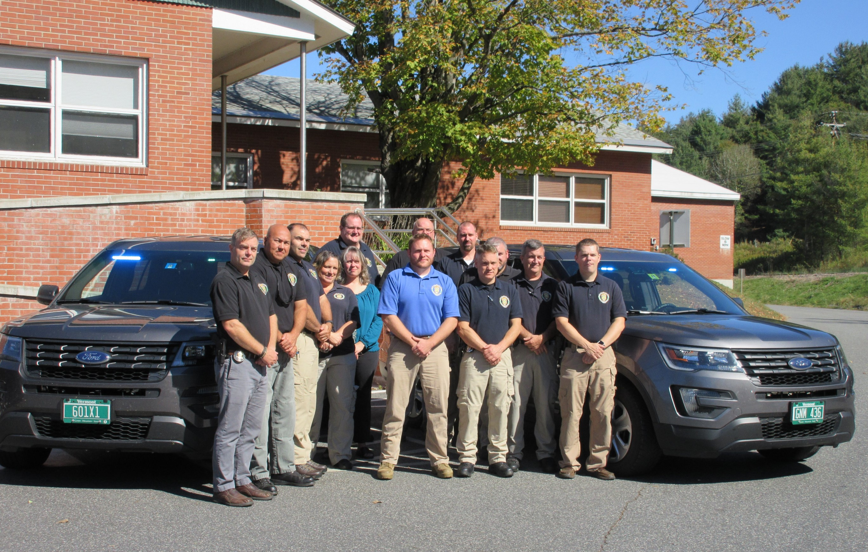
DLC Fast Facts:
To prevent underage consumption the Department
Conducts over 900 underage tobacco compliance checks each year
Conducts over 500 underage alcohol compliance checks each year
Received a grant to purchase ID verification equipment to identify and seize fake IDs and to prosecute those using these IDs
Conducts targeted team ID enforcement events with licenses
Educates gatekeeper of both tobacco and alcohol with over 8600 people being trained in 2016.

Slide 7
DLC Fast Facts:
The Department is fully Enterprise Funded – this means that no General Fund dollars are expended to pay for Departmental Operations
In FY 2017 the Department had
Gross Revenue of $86,960,000
Cost of Goods of $53,000,00
Operating Costs of $ 7,935,000
Net Profit of $25,275,000
All Department profits are contributed to the State General Fund
Since 2000 the DLC has contributed over $300,000,000 to the State General Fund

Slide 8
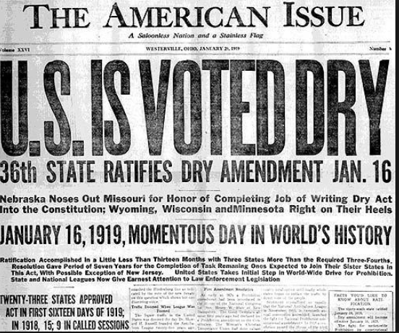
“Tonight, a minute after twelve, a new nation will be born. The drinking devil is writing his will. An Era of new ideas and clean manners starts. The ghettos will soon be part of the past. All jails and prisons will be empty; we’ll transform them into barns and factories. All men will walk upright once more, all women will smile and all children will laugh. The gates to Hell will shut forever. “These were the words Minnesota Republican Senator, Andrew Volstead, used to announce the beginning of the Dry Law.
1919 Start of National Prohibition

Slide 9
The Originators of the Control State Model for the Sale of a Controlled Substance

Slide 10
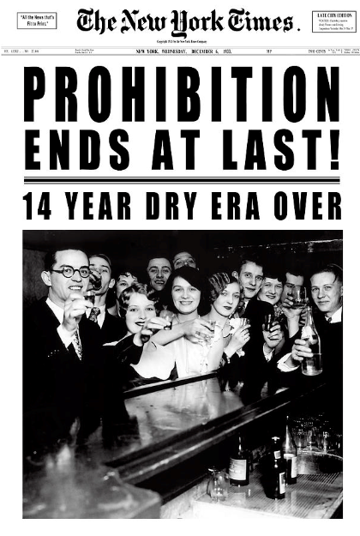

Slide 11
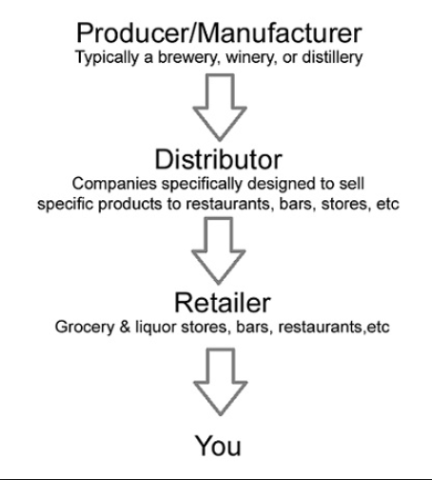
Control Model
At the end of prohibition all states instituted some form of three-tier system of producers, wholesale distributors, and retailers to promote moderation in consumption, prevent concentration of power, and raise revenues through taxes.
Vermont, along with sixteen other states and two counties in Maryland, directly control the sale of liquor at the wholesale level and are considered “control states” or “control jurisdictions”.

Slide 12
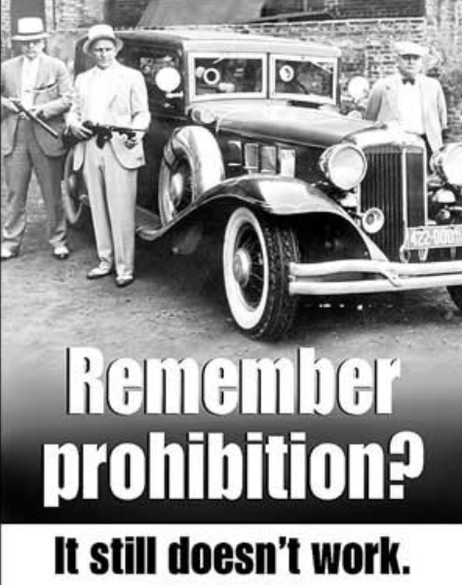
Rand Study Found Vermonters spend between $125 and $225 million per year on cannabis

Slide 13
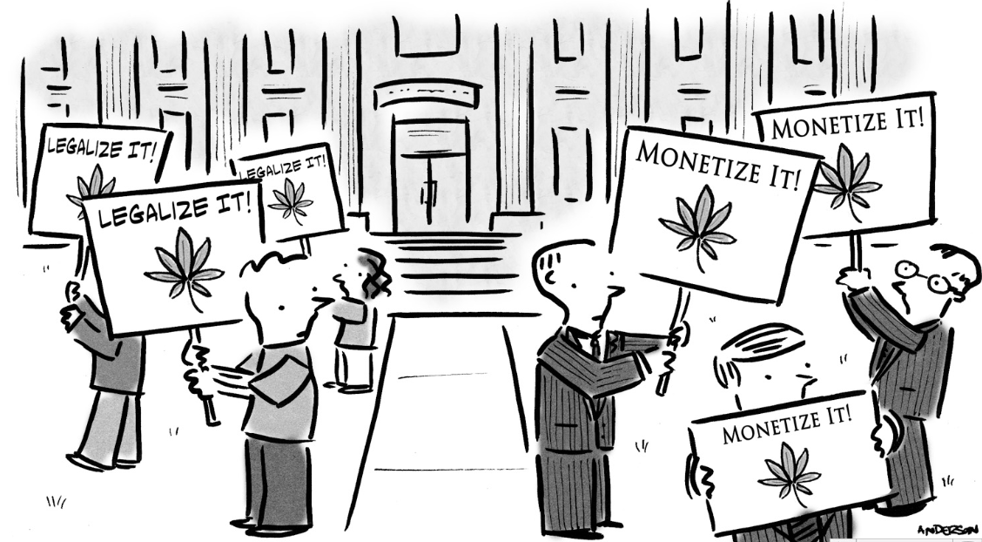
Benefits of the Control State Model
Primary focus is Social Responsibility NOT Profitability

Slide 14
Open Market Model Issues
In an “open market” the goal is to increase sales and profits
Encouraging use – pushing the product
By marketing to heavy users
Offering volume discounts to encourage heavy use
Marketing to underage youth to encourage consumption
Price wars between outlets to attract and keep customers
Increasing availability with more locations and extended hours
Willingness to tolerate a certain level of black market activity
Tax collection more difficult and avoidance more likely
Product diversion more likely

Slide 15
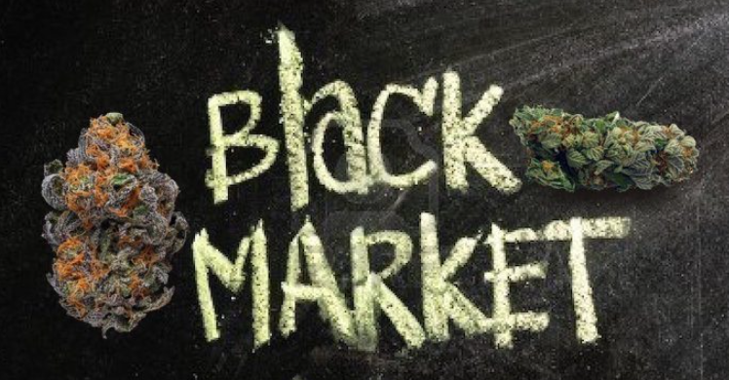
Benefits of the Control State Model
Under a control state model a fundamental goal would be the elimination of the black market which would be accomplished through:
Flexible pricing
Assurance of quality and strength of product sold in state stores
Assurance of purity (no harmful chemicals, fungicides or pesticides) of product sold in state stores
Clear labeling so consumers know what they are purchasing
Educating consumers that purchasing from the state supports local businesses and state government and not drug cartels and drug dealers

Slide 16
Benefits of the Control State Model
Creating a control state model for cannabis would maximize revenue to the state.
This would be accomplished by making the state the sole distributor and the retailor cutting out the middleman
As the retailor the state would:
Ensure uniform prices across the state
Limit access by controlling the number of retail locations and hours of operation
Ensure uniform selection across the state
More effectively keep questionable and high potency products out of the market
As the distributor and retailor tax collection would be maximized
As the retailor federal income taxes would be avoided allowing enhanced price flexibility to deal with the black market

Slide 17
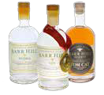
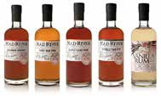
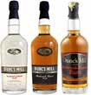
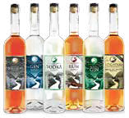
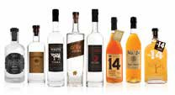
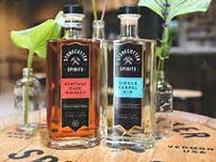
Benefits of the Control State Model
As the distributor the state would encourage small local producers to enter the market
This helps create a more vibrant market
Increases product selection for consumers
Creates additional employment around the state

Slide 18
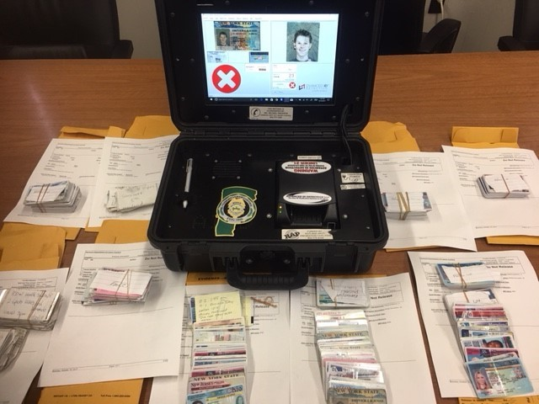
Benefits of the Control State Model
A contract agency store model provides the state with greater control over the sellers conduct helping to enhance compliance
By limiting the number of retail locations it is easier to conduct frequent compliance checks
Limiting abuse with restrictions on affordability, availability and accessibility
Licensing, education and enforcement are paid for out of revenue generated from consumption not General Fund dollars (pay to play)
Local Control is built into the control model and would allow municipalities to prohibit sales in their town (dry town)

Slide 19
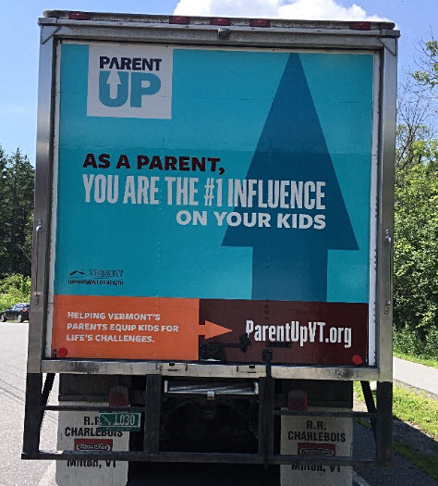
Questions
DLC Delivery Truck

Slide 20
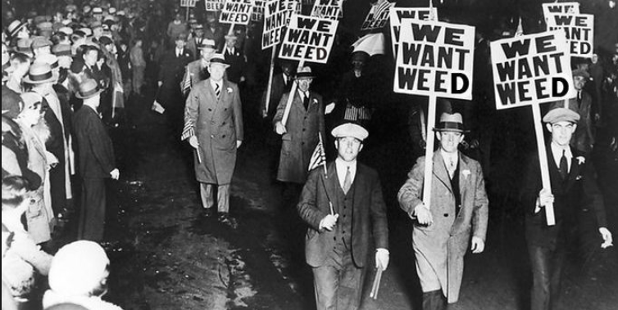

Slide 21
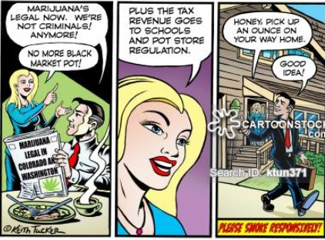

Slide 22
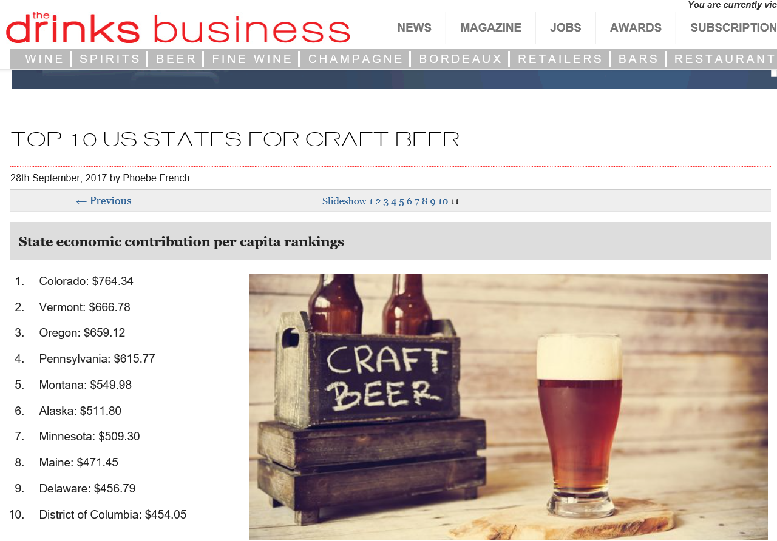

Slide 23
