Slide 1
A Ridiculously Brief Overview of Recent Marijuana Legislation in Vermont
Michele Childs, Esq.
Vermont Office of Legislative Council
September 28, 2017

Slide 2
Timeline of Vermont Medical Marijuana Legislative Actions
2001 - VT House passes a bill establishing a framework for possession and cultivation by patients with a debilitating medical condition. The bill does not advance, but the Legislature creates a study committee to examine the issue and how VT might implement a program.
2002 - The Committee reports favorably on the use of marijuana for medicinal purposes.
2004 - Vermont becomes the ninth state to approve medical marijuana by adopting “An act relating to marijuana use by persons with severe illness” which establishes a registry within the Department of Public Safety for patients and their caregivers who are permitted to possess and cultivate marijuana.

Slide 3
Medical marijuana continued…
2011 - Vermont enacts legislation to allow up to four dispensaries to provide marijuana to a maximum of 1,000 registered patients. Dept. of Public Safety directed to adopt rules and provide oversight for dispensaries.
2014 - The Legislature eliminates the patient cap, authorizes delivery to patients, and permits naturopaths to qualify patients for the registry.
2016 - The Legislature expands patient eligibility, requires infused products to be dispensed in child-resistant packaging and to be labeled with the amount of THC in a single dose, and allows a dispensary to provide marijuana to a postsecondary academic institution for research purposes.
2017 - Vermont authorizes a fifth dispensary (and eventually a sixth), allows each dispensary to dispense to patients and caregivers at up to two locations, and expands the list of qualifying conditions.

Slide 4
Decriminalization in Vermont (2013)
Possession of an ounce or less by a person 21 years of age or older is subject to a civil penalty similar to a traffic ticket. Those under 21 years of age are referred to Court Diversion and enrollment in the Youth Substance Abuse Safety Program.

Slide 5
2015-2016 Legislative Biennium
In 2015, then Senator David Zuckerman introduced S.95, An act relating to regulation and taxation of marijuana.
The Senate Committee on Government Operations held hearings every Friday afternoon to discuss the regulatory structure for an adult-use marijuana market.
In 2016, Sens. White and Benning introduced S.241, An act relating to regulation of marijuana.

Slide 6
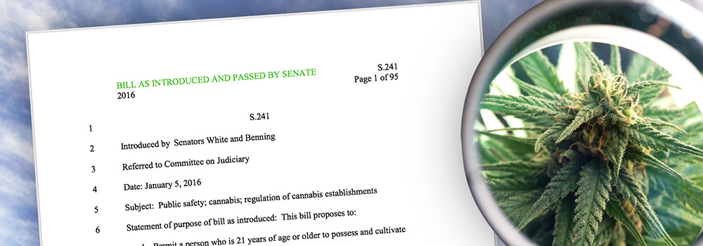
S.241’s Journey
The bill removed penalties for 21+ possession of an ounce or less of marijuana; created a regulatory and taxation structure for licensed cultivation and sale of marijuana; funded marijuana prevention, education programs, and highway safety measures; and created a commission to oversee the implementation of the law.
Over the course of two months, the bill was considered and voted on favorably by the Senate Committees on Judiciary, on Finance, and on Appropriations and passed the Senate on a vote of 17–12.

Slide 7
S.241 Legislative Intent
Any efforts to legalize and regulate marijuana must comply with the 2013 memo from Deputy Attorney General James M. Cole regarding guidance to states that elect to legalize marijuana in some form, as well as the principles articulated in the Governor’s 2016 State of the State address.
Vermont seeks to take a new comprehensive approach to marijuana use and abuse that incorporates prevention, education, regulation, treatment, and law enforcement and results in a net reduction in public harm and an overall improvement in public safety.
Revenue generated by the act shall be used to provide for the implementation, administration, and enforcement of the act and to provide additional funding for State efforts in the prevention of substance abuse and treatment of substance abuse, and criminal justice efforts to combat the illegal drug trade and impaired driving. As used in the act, “criminal justice efforts” shall include efforts by both State and local criminal justice agencies, including law enforcement, prosecutors, public defenders, and the courts.

Slide 8
Components of S.241
Prevention and Education
Adult Use; Legal Possession; Civil and Criminal Penalties
Youth Access and Prevention
Licensing and Regulation of Marijuana Establishments
Local Government
Medical Marijuana Dispensaries
Impaired Driving
Workforce Study Committee
Marijuana Program Review Commission
Marijuana Regulation and Resource Fund; Appropriations; Positions

Slide 9
Timeline for Implementation

Slide 10
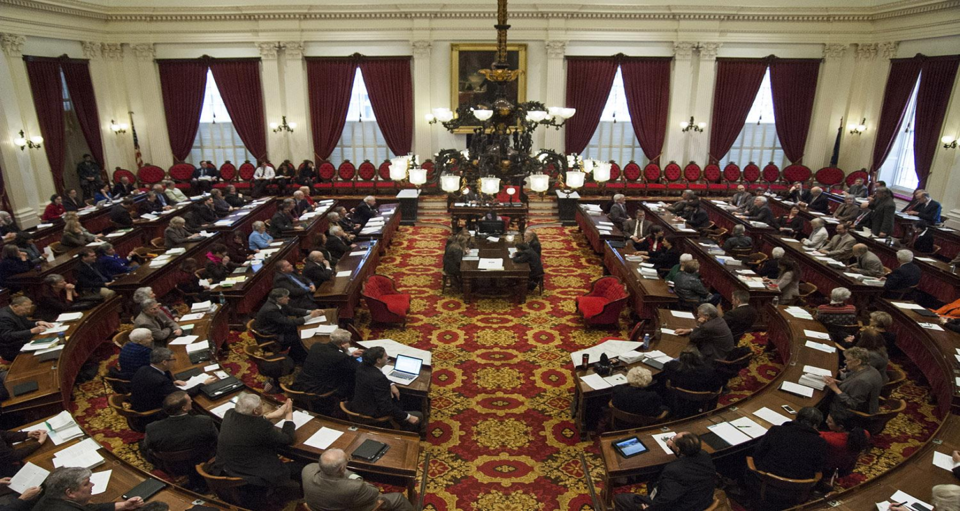
In the House, S.241 was first referred to the Committee on Judiciary, which stripped most of the bill, leaving provisions on removing penalties for 21+ possession of an ounce or less of marijuana, prevention and highway safety, and creating a study commission. The bill advanced to Ways and Means which added a provision allowing “homegrow ”with the purchase of a permit. The bill continued on to Appropriations where the bill died.

Slide 11
Joint Legislative Justice Oversight Committee Meetings Fall, 2016
Request from Sen. Sears and Rep. Grad to hold additional six meetings of the Joint Committee on Justice Oversight during adjournment for the purpose of examining legalization and regulation of marijuana.
“These issues are clearly important to Vermonters and we would like to continue the conversation in hopes of developing a modern approach to marijuana policy that reflects the values, culture, and scale of Vermont. Our goal will be to develop a comprehensive approach to marijuana that addresses prevention and education for youth, possession and cultivation for adults 21 years of age or older, and a regulatory and revenue system for an adult-use marijuana market that, when compared to the current illegal marijuana market, increases public safety and reduces harm to public health.”

Slide 12
Letter to Vermont’s Congressional Delegation
“The Justice Oversight Committee has voted unanimously to ask that you work toward amending federal law to allow states to set their own marijuana and hemp policies without federal interference, to restrict Department of Justice funding used to prevent states from implementing their own state laws that authorize the use, distribution, possession, or cultivation of marijuana for medical purposes, and urge the new administration not to undermine state marijuana and hemp policies that are otherwise in compliance with federal priorities previously outlined.”

Slide 13
Committee’s Recommendation
The Committee did not take “a position on whether Vermont should legalize marijuana for adult use but [recommended] that if the General Assembly does advance such a proposal, it should include a well-regulated commercial market that includes small cultivators, an allowance for adults 21 years of age or over to cultivate up to two mature and seven immature marijuana plants and the marijuana that is harvested from those plants, a strong education and prevention program aimed at youth under 25 years of age that is rolled out well in advance of any retail sales of marijuana, and a financing structure that covers all costs to the State related to legalization of marijuana while supporting a regulated market that can undercut the illegal market in hopes of moving illegal sales into the regulated market. In consideration of these issues, the Committee recommends that the General Assembly pay close attention to any federal guidance coming from the new administration and keep in contact with other states that have legalized marijuana or are considering legalizing marijuana to keep abreast of the latest policy, practices, and challenges.”

Slide 14
S.14 (Act No. 168)
An act relating to amendments to the marijuana for medical symptom use statutes

Slide 15
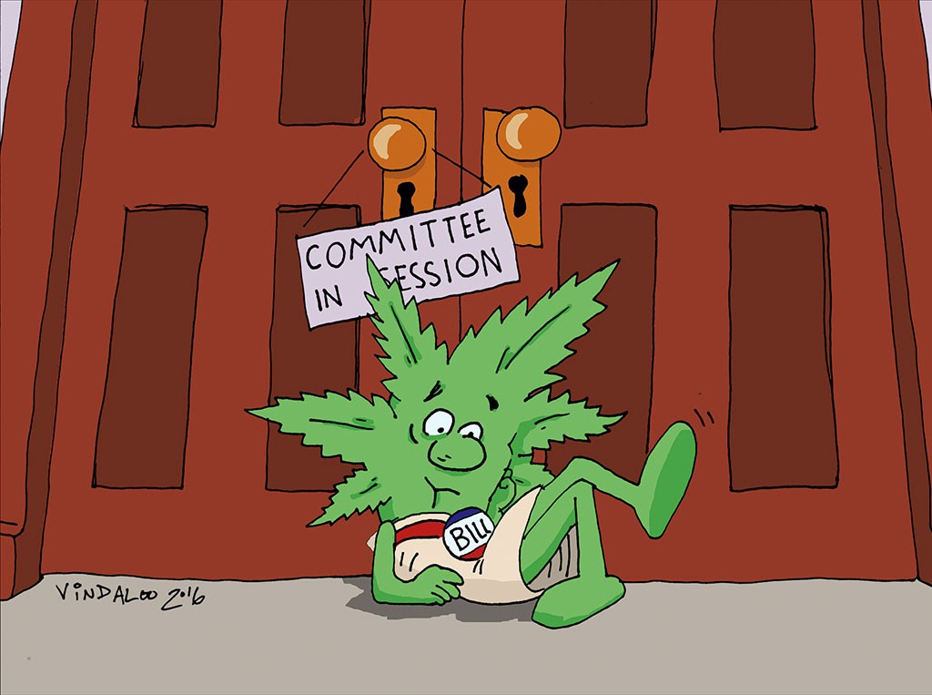
2017–2018 Legislative Session
S.22, H.167, H.170, H.490, H.511

Slide 16
H.490, An act relating to the regulation of commercial cultivation and sale of marijuana
Substantially similar to S.241 of 2016
Small differences as to regulatory agency, increase in the number of small growers, and corporate structure for licensees
Sitting in House Committee on General, Housing and Military Affairs with no action taken to date

Slide 17
H.167, An act relating to alternative approaches to addressing low-level illicit drug use
Originally directed the Office of Legislative Council to examine the issue of a public health approach to low-level possession and use of illicit drugs in Vermont as an alternative to the traditional criminal justice model, looking to trends both nationally and internationally, with a goal of providing policymakers a range of approaches to consider during the 2018 legislative session
On 4/20, Senate stripped the bill and added a tweaked version of S.241 (allowing “homegrow,” moving primary regulatory authority from DPS to AAFM, and increasing the number of small cultivator licenses)
Upon arrival in the House, the bill was ordered to lie

Slide 18
H.170, An act relating to possession and cultivation of marijuana by a person 21 years of age or older
Created Washington, D.C. system of personal possession, but no commercial sales or regulation
House Judiciary voted out of committee, but once on the floor, the bill was sent to the Committee on Human Services
The bill emerged from HHS and on May 3 was passed by the House on a final vote of 75 to 71
Bill currently sits in the Senate Rules Committee because it did not reach the Senate until well past deadline for consideration

Slide 19
S.22, An act relating to eliminating penalties for possession of limited amounts of marijuana by adults 21 years of age and older
Resurrected H.170 language and allowed personal possession of one ounce, two mature plants, four immature plants as of July 1, 2018 (Washington, D.C. model)
Created Marijuana Regulatory Commission to develop legislation by November 1, 2017 for creating comprehensive regulatory system for commercial sale of marijuana
Vetoed May 24, 2017

Slide 20
H.511, An act relating to highway safety
Resurrected S.22 and retitled it “An act relating to eliminating penalties for possession of limited amounts of marijuana by adults 21 years of age or older”
Increased penalties and created new crimes for offenses related to using marijuana near or dispensing marijuana to persons under 21 years of age
Reconfigured the Commission and its mission and pushed the Commission’s legislation due date to December 31, 2018
Passed Senate, but it did not receive rules suspension in the House, so it could not be debated during the one-day veto session

