Slide 1
Proposal for Cannabis Regulation in Vermont Vermont Agency of Agriculture, Food & Markets

Slide 2
VAAFM activities to date or in progress
State hemp regulation
State certification of pesticide applicators
Laboratory method development-resources
Authority to provide access to approved (legal) pesticide products
National Workgroup to obtain multi-state input for human & environmental risk assessment resources (toxicology, env. fate, worker exposure…)
National agriculture workgroup “proposed model bill”

Slide 3
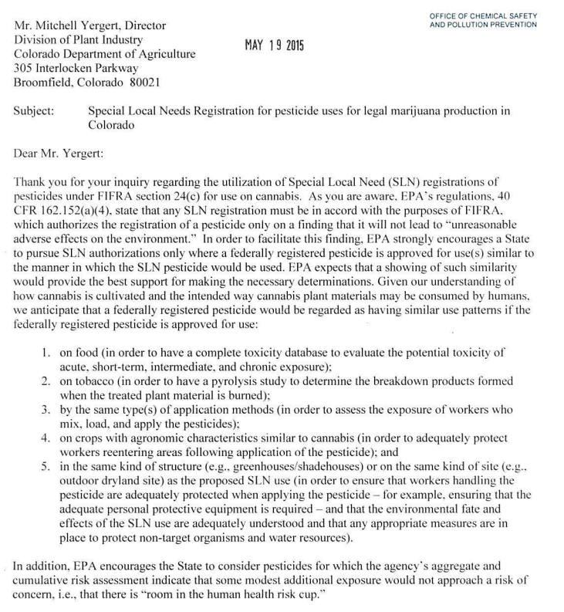
EPA Special Local Needs State registration for pesticide products
EPA letter of intent of Colorado
Provided a path forward
Outlined conditions required:
http://www.epa.gov/sites/production/files/2016-01/documents/epa_letter_to_cda_5-19-15_slns_for_marijuana.pdf
Requires states to perform risk assessments
Requires support from the pesticide product registrants
Notes:
Currently individual States are developing their own “Lists” of approved products.

Slide 4
State FIFRA Issues Research & Evaluation Group SFIREG
Workgroup – Created December 2015
NV has been developing two SLN applications.
CropLife America has expressed concerns from registrants, and want to be included in a workgroup. Conversation to extend to hemp.
Risk cup considerations are a significant issue. If the risk cup is already close to full, the product will not be pursued.
Colorado agricultural statistics for the 2015 season show $800 M for alfalfa, $700 M for cannabis, and $600 M for corn.

Slide 5
Why do we need legal pesticides and certified applicators?
If there is not a legal solution growers will use whatever works.
High residues in concentrates
Undisclosed pesticide active ingredient in products
Word of mouth
Pesticide product Guardian™ ordered removed from sale, growers asked to stop its usage
February 5, 2016... The Oregon Department of Agriculture has ordered stoppage of sale and the removal of the pesticide product Guardian, which is labeled for use on ornamental, food, and feed crops for mite control but also used by cannabis growers. In addition, ODA is asking growers who may have purchased the pesticide product to refrain from using it. ODA’s actions come following an investigation of the product that found the presence of the pesticide active ingredient abamectin, which is not listed on the product label.
Notes:
The product label identifies the active ingredients as cinnamon oil and citric acid, and claims the product is 100 percent natural. the investigation was a result of concerns of product adulteration brought to the agency by a private laboratory as well as representatives of the cannabis industry. Oregon Pesticide Program obtained and sampled Guardian from several retail locations in Oregon. Laboratory analysis found the presence of abamectin.
Exposure to over tolerance residues of abamectin have been linked with neural degeneration..

Slide 6
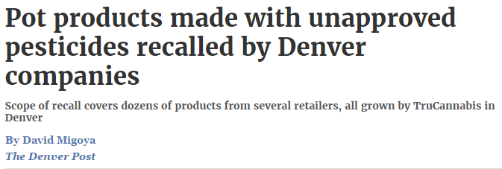
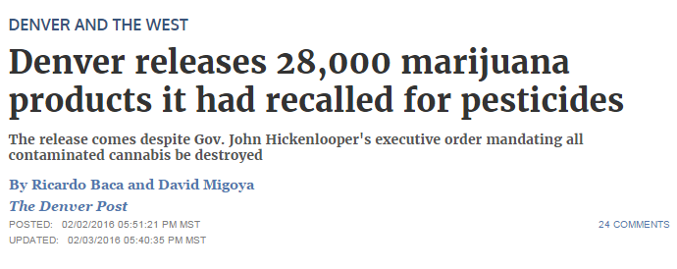
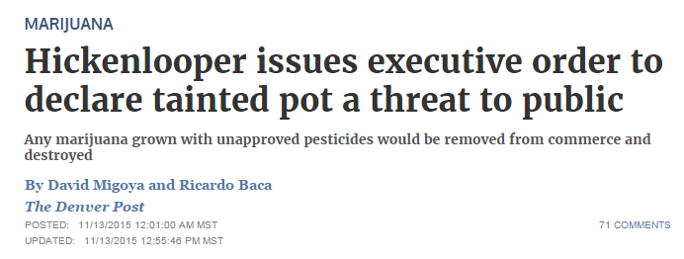

Slide 7
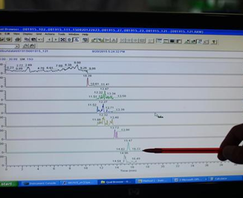
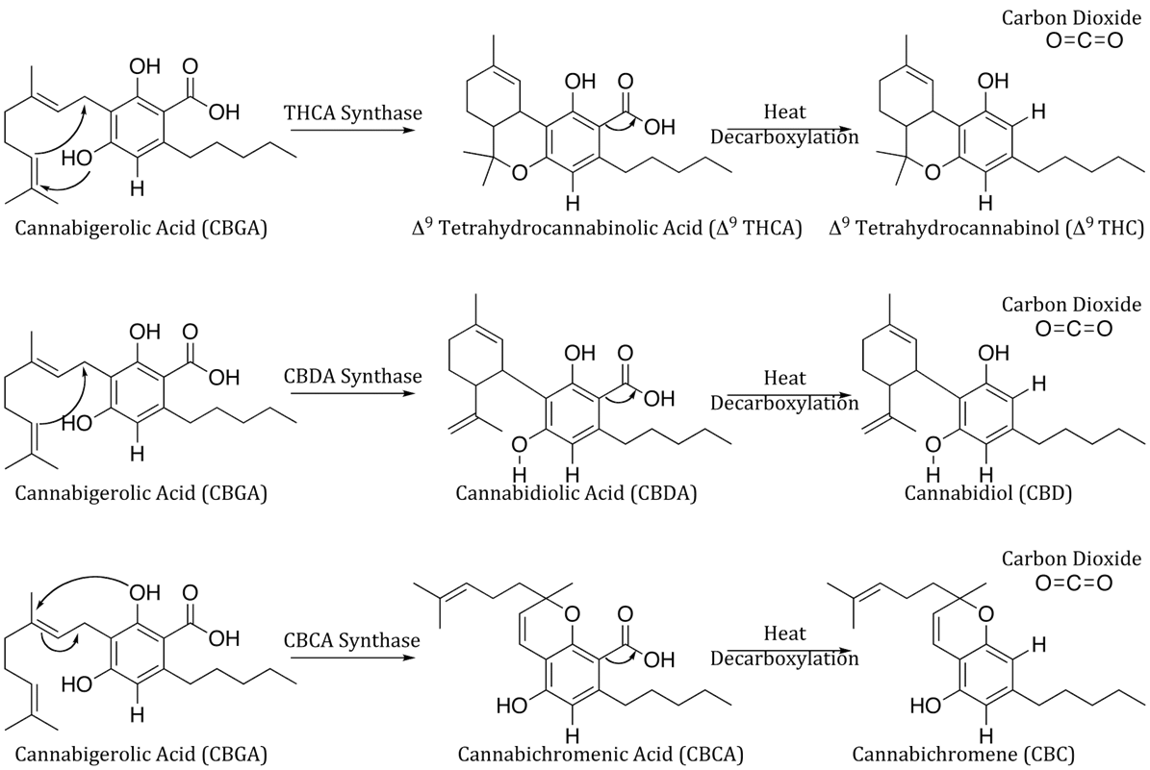
Cannabis regulatory program at the Agency of Agriculture
Cannabinoid concentration validation
THC
THCA
CBD
CBDA
CBN
Pesticide Residue Analysis
Adulterated products
Powdery Mildew
Pathogens (e-coli, salmonella)
Establish testing protocols and reporting requirements for Vermont
Notes:
THC labeled and reported on an as sold or dry matter basis?
THCA conversion. Some report 100% conversion some use 86%
Standardize reporting set analytical variation.

Slide 8
Proposed Agency responsibilities under Vermont regulatory framework
Cultivation and processing operations addresses cultivation practices, pesticide use, facility requirements, management of water resources, record keeping, Worker protections standard compliance, and information disclosure.
Laboratory operations is a complement to existing good laboratory practices, these recommendations focus on the personnel, security, sample handling and disposal, and data management and reporting activities that may be unique to laboratories analyzing cannabis samples.

Slide 9
Agriculture Program Development
Have
Need
Condemnation authority over raw agricultural commodities (flowers) –when deemed adulterated.
Pesticide use & applicator certification regulatory authority
Consumer protection (recalls), environmental and human health program experience
In-depth knowledge of pesticide registration process
Condemnation authority over all cannabis products. (oils, dabs, waxes and shatters)-when deemed adulterated.
Authority for laboratory standards
Funding
Human resources

Slide 10
Opportunities
Build on pre-existing partnerships with other states that have gone before Vermont
Nationwide Network of State Regulators currently dealing with cannabis
Relationship with EPA and Pesticide registrants
Development of Vermont specific standards for cannabis production
Nutrient best management practices
Cultivation input controls: Fertilizers, heavy metals, pathogens, approved pesticides

Slide 11
Immediate Needs
Program Lead: Assemble internal Cannabis Program Development team
Legal Support: Rules development
Outreach: Stakeholder group. Vermont Cannabis Collaborative- Dispensary involvement
Authority to possess Standards & Material
THC analysis methods development
Pesticide residue method development
Pathogen testing

Slide 12
Future Needs
Field Inspection Support
Program Support
Laboratory Staff and Instrumentation
Agricultural Development coordination
Outreach and compliance assistance

Slide 13
Cannabis Consumption Survey
This survey is intended to obtain a better understanding of the type, manner and amount of marijuana consumed by end users.
Responses will be used to develop future pesticide use risk assessments to determine potential exposures to residues on cannabis.

Slide 14
Cannabis Consumption Survey
Who?
Age Range
What?
Flower
Concentrates
How?
Inhalation
Ingestion
Transdermal
How Much?
How Often?

